Slide 1
WHAT MUST I DO?
Christ’s blood breaks sin’s stronghold
Bangkok Holiness Writers' Conference
September 2017

Slide 2
[1] God
[2] us
[3] our relation to Him

Slide 3
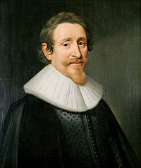

Slide 8


Slide 9
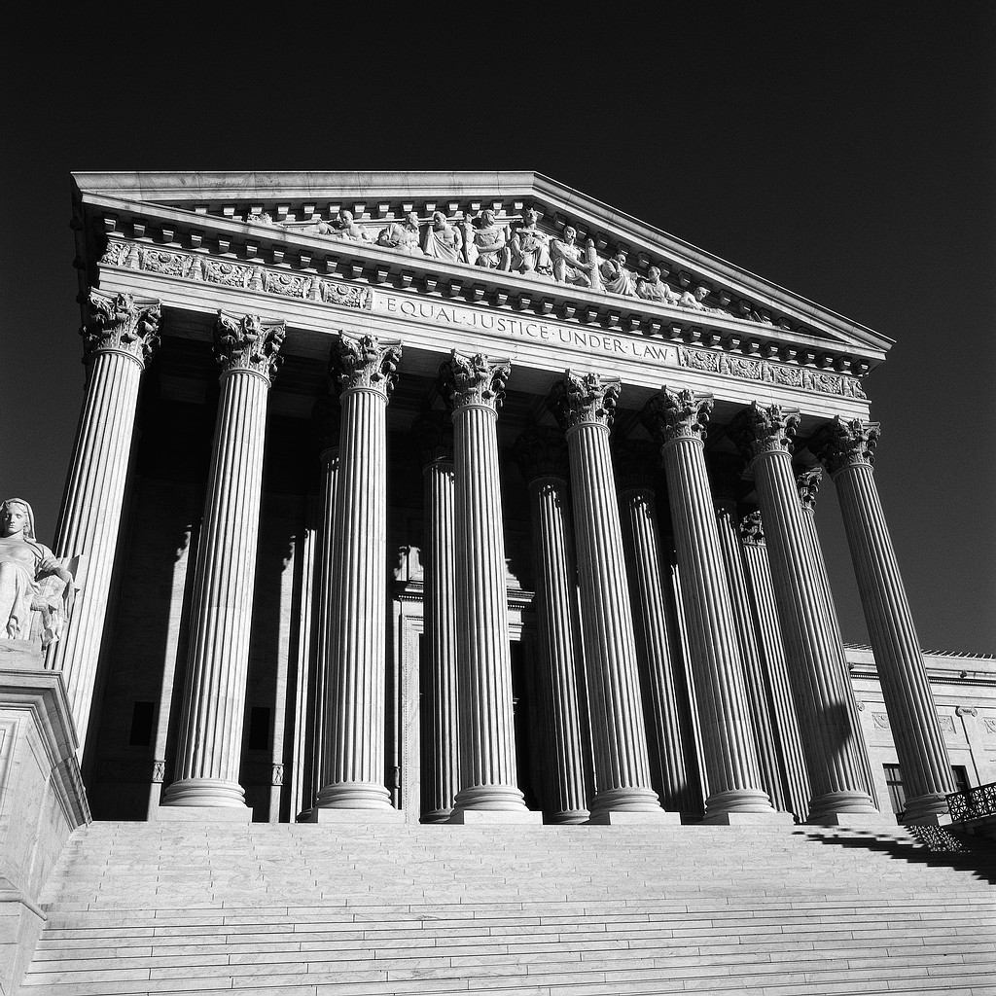

Slide 10


Slide 12
[1] God
[2] us
[3] our relation to Him

Slide 13
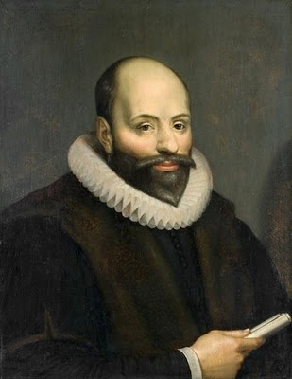

Slide 14
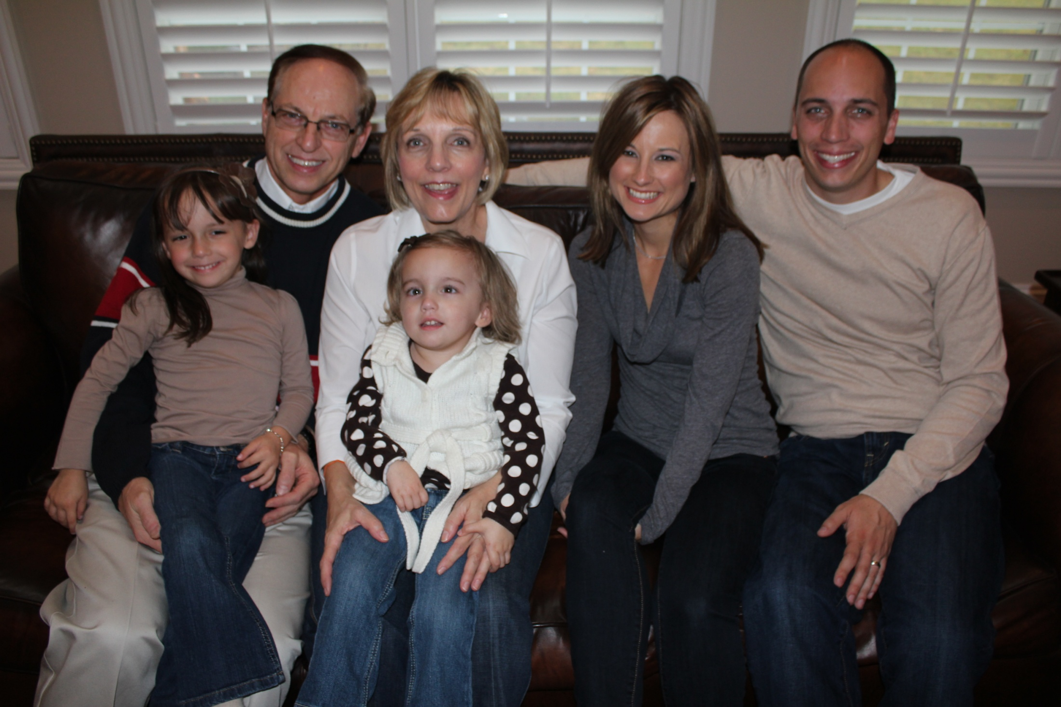

Slide 15


Slide 16


Slide 17


Slide 18


Slide 19


Slide 21
For you did not receive a spirit that makes you a slave again to fear, but you received the Spirit of sonship. And by him we cry, "Abba, Father." Romans 8:15

Slide 22
Because you are sons, God sent the Spirit of his Son into our hearts, the Spirit who calls out, "Abba, Father." Galatians 4:6

Slide 23
You fathers—if your children ask for a fish, do you give them a snake instead? Or if they ask for an egg, do you give them a scorpion? Of course not! So if you sinful people know how to give good gifts to your children, how much more will your heavenly Father give the Holy Spirit to those who ask him.
Luke 11:11-13 (NLT)

Slide 25
3 Questions:
Do I need for a holy heart?
Am I determined to seek a holy heart with all my being?
Am I willing to give God everything?

Slide 26
Be Filled with the Holy Spirit
Offer your life completely to God. (Romans 12:1-2)
Surrender your life to Him.
(Romans 12:1)
3. Confess your need. (Luke 11:13)

Slide 27
4. Consecrate your life. (2 Corinthians 7:1)
Obey the voice of the Spirit. (Acts 5:32)
6. Believe God in faith. (1 Thessalonians 5:23-24)

Slide 28
God can transform you into the person He’s always wanted you to be!

